Slide 1







August 17th, 2021
PM: Hunter
Frontend: Jacob Sandling, Justin Kwong
Backend: Hunter, Brian Lin, Zhenyuan Gong, Dingheng Yan
Notes:
Presenter: Hunter
Hello everyone! We are Poll Buddy. I’m Hunter, the project manager, and I’m going to start us off by giving an overview of our app and how we’re developing it, and later you’ll hear from the other Poll Buddies some in depth details about the different portions of the project.

Slide 2
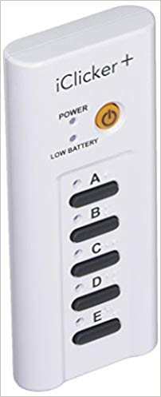
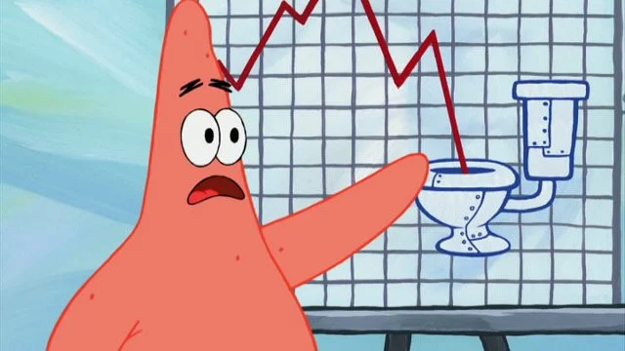
What is Poll Buddy?
Website alternative to iClickers
Virtual polling system
Affordable, easy to use, and interactive
Powerful views for everyone
Integrated with RPI’s CAS
Notes:
Presenter: Hunter
So jumping right in, what is Poll Buddy? As a quick overview, Poll Buddy is a website alternative to iClickers. iClickers are classroom tools used to get responses from students, but they have some major limitations. We’re building a virtual polling system that’s affordable, easy to use, and interactive for everyone. We also are now integrated with RPI’s CAS login system, and hope to add other integrations like Submitty in the future.

Slide 3
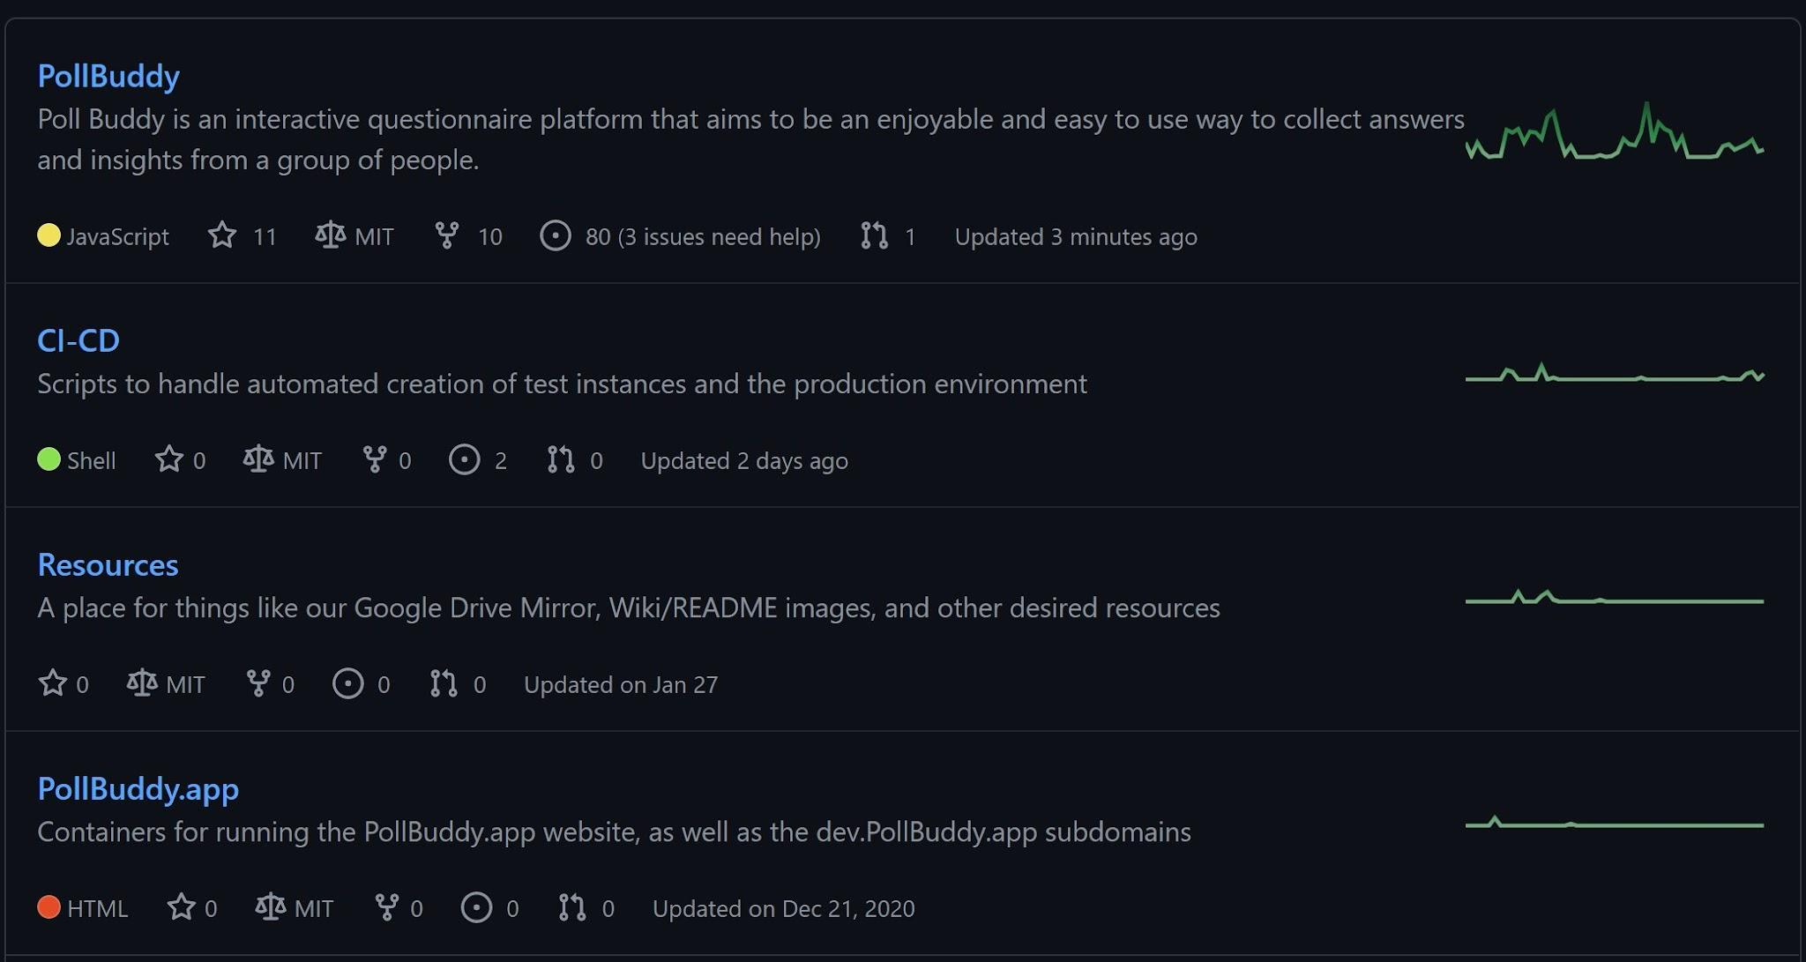
Poll Buddy Info
Public Beta Product: End of Fall 2021
Repos: https://github.com/PollBuddy
Licenses: MIT
Contributors: Anyone can access the repos
Poll Buddy members can work directly with the repo through branches and pull requests. Outside contributors can fork and PR.
Github issue list gives potential tasks to work on.
We also have a Contribution Guide and Wiki with ever expanding documentation.
Notes:
Presenter: Hunter
We’ve been working on Poll Buddy for 6 semesters now, with lots of designing, building, and refining as we go along. We’re hoping to do beta testing in RCOS at the end of the fall semester, and use feedback from that to finish preparations for a wider rollout. We’ve made a ton of progress over the semesters and everything has been coming together nicely.
On this slide, I’ve linked our Github Organization page that contains the 4 repos we have, as well as their licenses. As for contributors, everything is open source and we have a wiki with a contribution guide and other information about the app to aid in development and understanding how everything works.

Slide 4
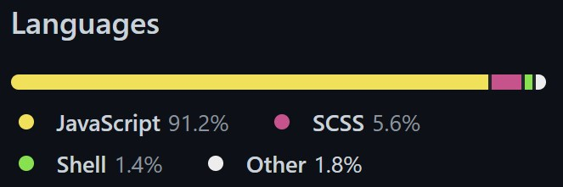
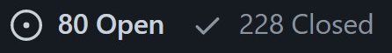
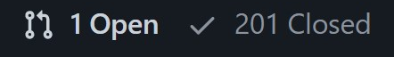
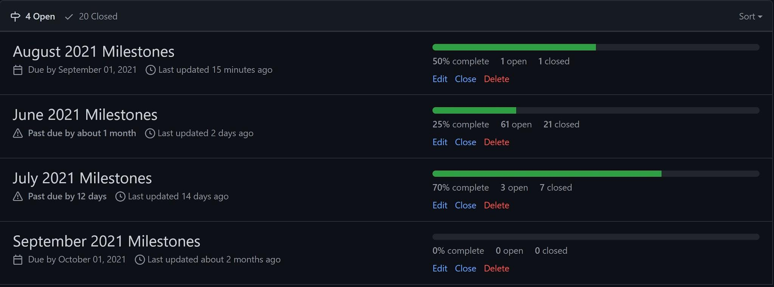
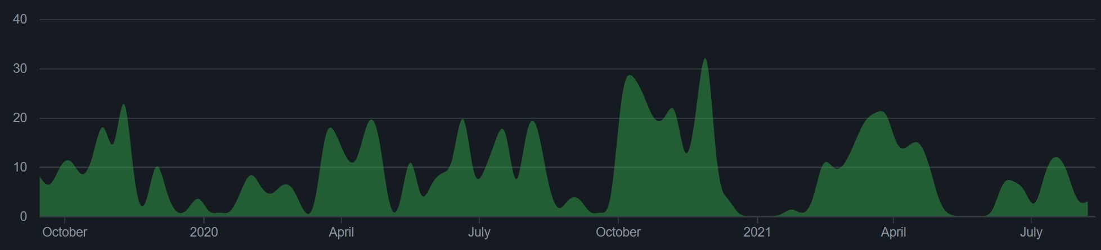
Managing the Project
Milestones were broken down into months and issues per month.
Issues used as trackers for todo items. Labeled frontend / backend / other tags as relevant.
1335 total commits to master (as of 8/13/2021)
Contributions to master, excluding merge commits:
Notes:
Presenter: Hunter
As for project management, we track to-do items through Github Issues, and link them to monthly milestones to prioritize them somewhat. I’ve also included some assorted stats about the main repo, as well as some figures about our total number of issues and pull requests on the right, language usage breakdown at the top, and monthly commit amounts at the bottom left.

Slide 5
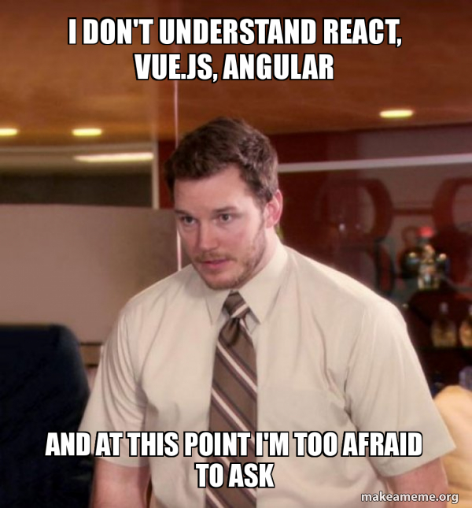


Front End
Notes:
Hunter: That’s all for me, now I’ll pass it off to Justin to talk about the frontend.
Presenter: Justin
Hi I’m Justin and I’ll be going over the frontend part of the app. In terms of technologies used for the frontend, on the left, as you can see we used React.js as the framework for Poll Buddy, the thought process behind this decision was because of its flexibility and how easy it us to pickup. We also used React Bootstrap, as you see on the right, that gave us some pre-made design components that made developing a bit easier.

Slide 6
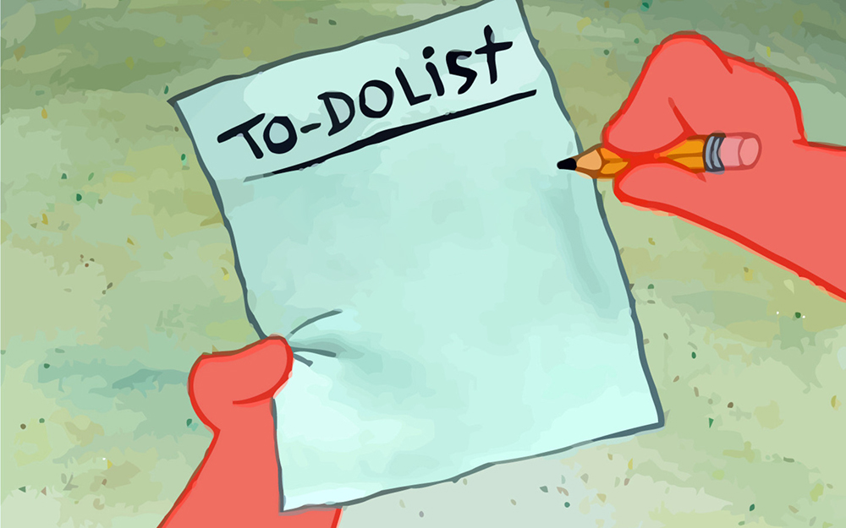
Frontend Tasks
Completed:
Login/Registration robustness fixes
More documentation
More account info page functionality
In Progress:
Backend integration
Early testing
Poll
Buddy
Take over
Change the world
Notes:
Presenter: Justin
We’ve made some more progress this semester in order to reach our goals from the proposal, mostly the things you can see on this slide. We still have some things we need to work on, but we’ve made a lot of progress up to now.
In terms of completed tasks, much of the login and registration interface was cleaned up and made more robust. This semester, we also added more documentation for the front end like a README for the front end. And lastly in completed tasks, we added some functionality for the account info page.
There are certain tasks that we are continuing to work on, such as integrating the backend with the frontend as well as some early testing for the web app itself.

Slide 7
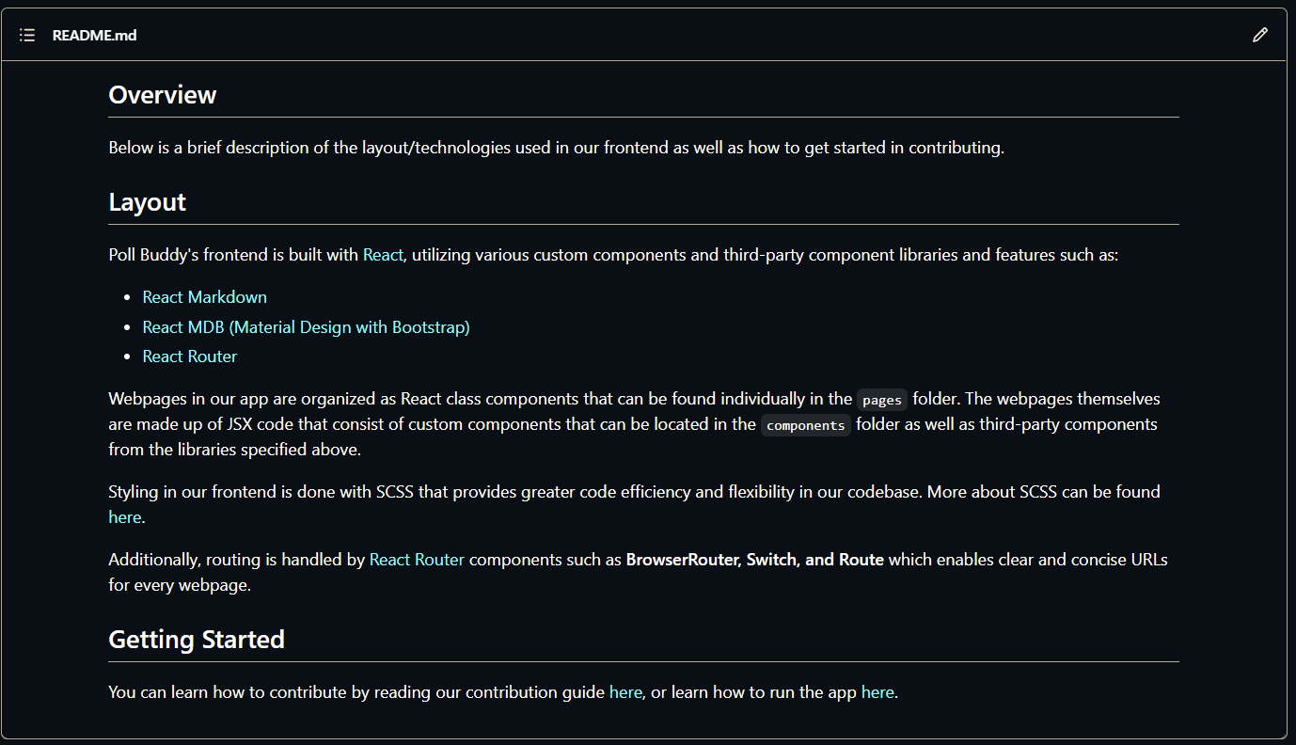
Frontend Documentation
Notes:
Presenter: Justin
Much of this semester, I worked on frontend related issues. I really wanted to try and improve and hone my skills when it comes to web development and using React. In terms of documentation, I added a brief but fairly comprehensive README file that outlined the frontend and all the technologies that are used for it. As the project gets even bigger and more complex, this README should hopefully help future contributors of Poll Buddy to get started a bit more quickly and easily.

Slide 8
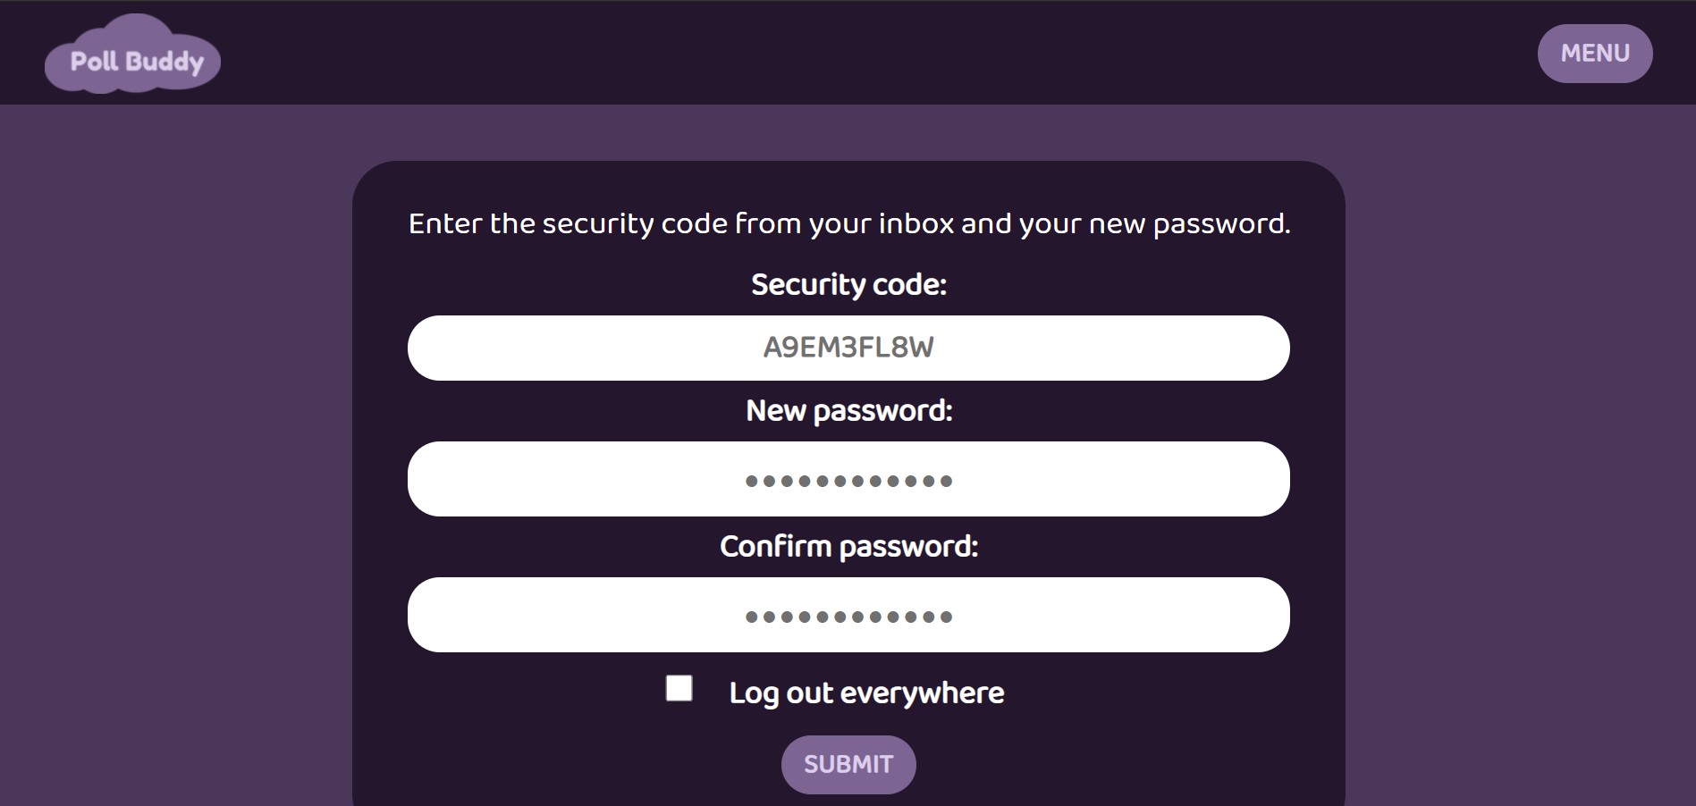
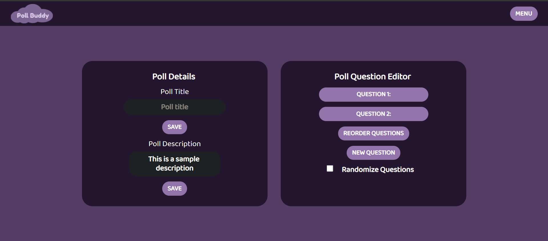
Frontend UI Toggles
User Log Out Everywhere Toggle
Dynamic Question Randomization Toggle
Notes:
Presenter: Justin
Other frontend contributions that I made were UI toggles that would add a bit more flexibility and functionality for users. One toggle would allow users to log out everywhere whenever they were on the reset password page. The second toggle was for professors and poll creators that wanted to randomize question order when they had two or more questions.

Slide 9
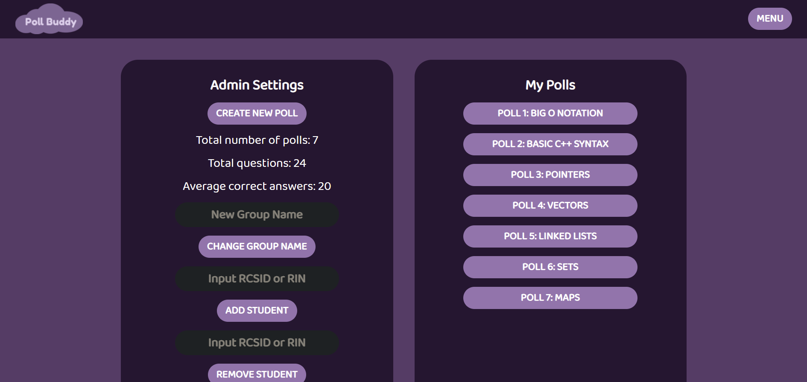
Frontend UI Touch Ups
Notes:
Presenter: Justin
Lastly, I also worked on touching up some UI elements. Many buttons across the site were unaligned at the center so I ended up centering these buttons.

Slide 10
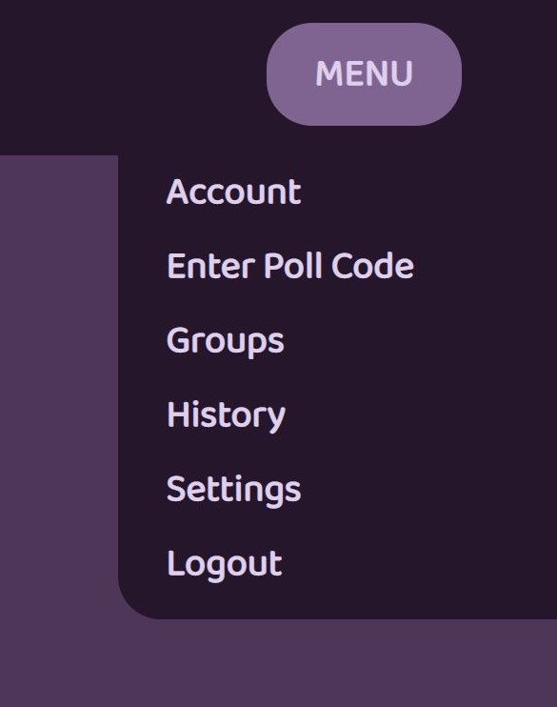
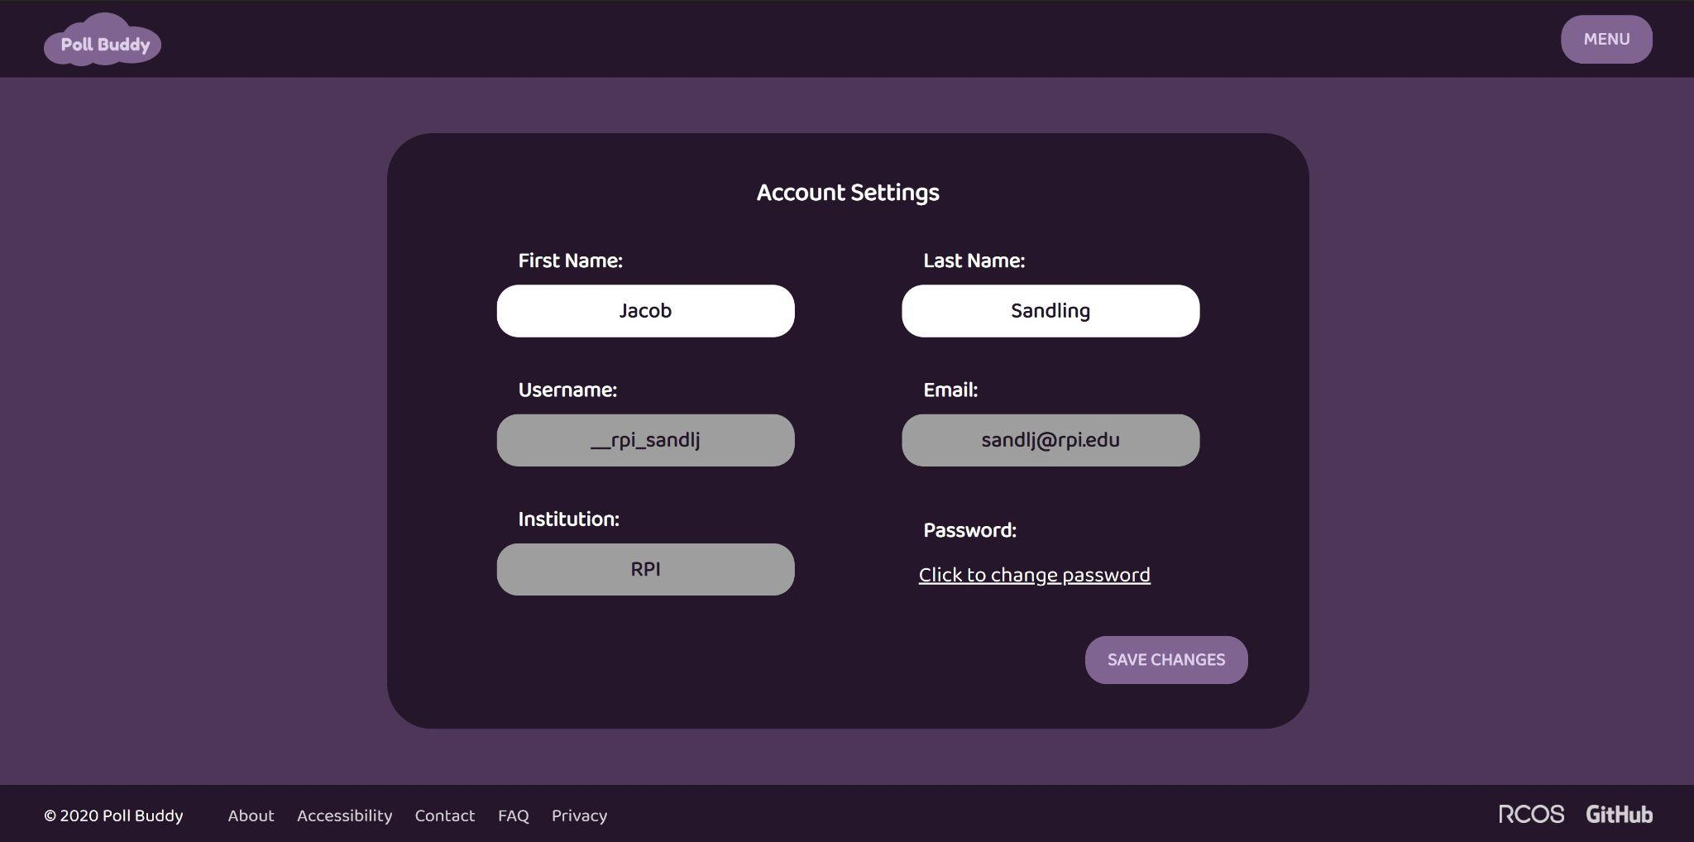
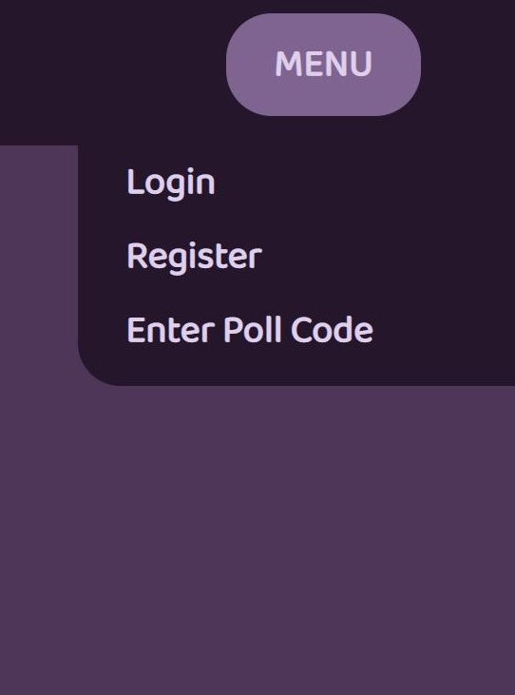
Dynamic Dropdown menu and Account Info Page
Logged In:
Dynamically loaded and updated
Not Logged In:
Notes:
Presenter: Jacob
This semester I spent most of my time addressing problems on and refining the frontend. This was my first time really working with web programming, and it was a really good way to get comfortable with using it. A couple of the things I worked on were updating existing components to make them work dynamically with a user’s login status and information. For example, I reworked our dropdown menu to display different options to logged in users, providing them access to more of the site. I also updated the Account page to load in the user’s information, and allow them to update these fields.

Slide 11




Back End
Technologies
Docker
NodeJS
Express
MongoDB
Notes:
Presenter: Jacob
And now for the backend! As a brief overview, we’ve got several technologies used in the backend. We use Docker to package up and run the app simply and easily, NodeJS to run the JavaScript code we use, Express to make it easy to set up an API, and MongoDB to store all our long term data.

Slide 12
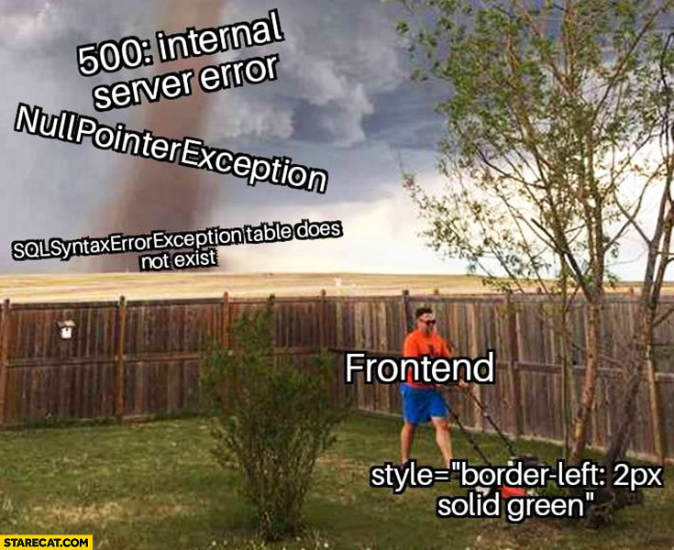
Backend Tasks
Backend Future Tasks
Further integration with frontend
API documentation
Additional endpoints for frontend features
Endpoint renovation, updating
Further frontend integration
Additional helpful functionality
Further logging/reporting capabilities and graphs
Submitty integration
Anti-cheating
And much more!
Notes:
Presenter: Jacob
Some of the goals this semester were to further the integration with frontend, add more documentation and functionality, and renovate some of the early endpoints so they match our current designs and needs.
As for our future goals, we aim to finish the frontend/backend integration, add more functionality on top of our core focus, and much more.

Slide 13
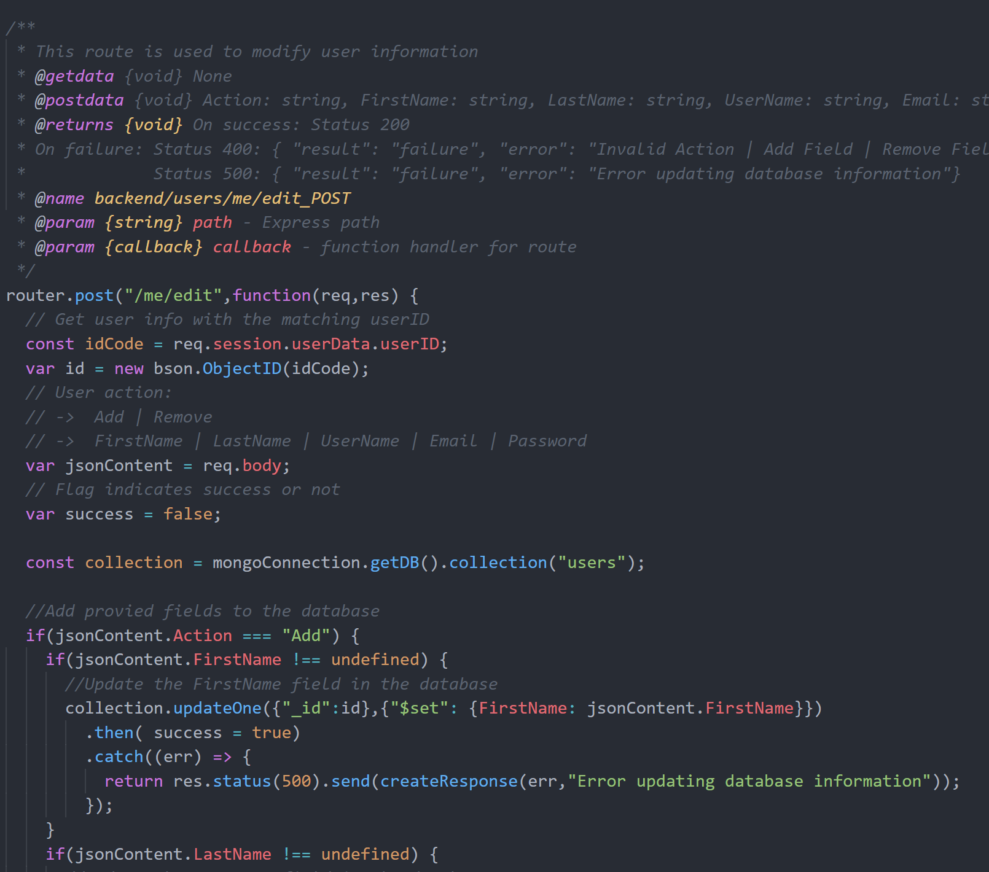
users/me/ Routes
/me
/me/edit
/me/groups
Notes:
Presenter: Jacob
I also spent some time creating the /me/ backend routes, which provide easy access to the current user’s data. Our previous backend routes for users relied on the frontend passing the user’s id, and by getting rid of that restriction, these routes can now be used from anywhere, not reliant on being passed correct data. They use the user ID stored at login to access the database, and allow us to retrieve the user’s name, email, and other information with /me, we can edit that information with /me/edit, and we can get all the groups a user is a part of with /me/groups.

Slide 14
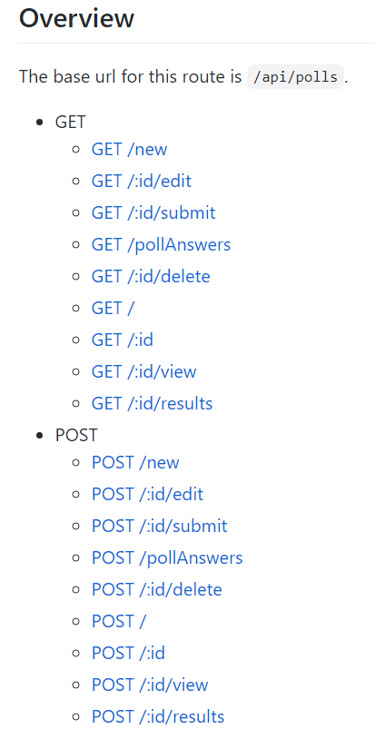
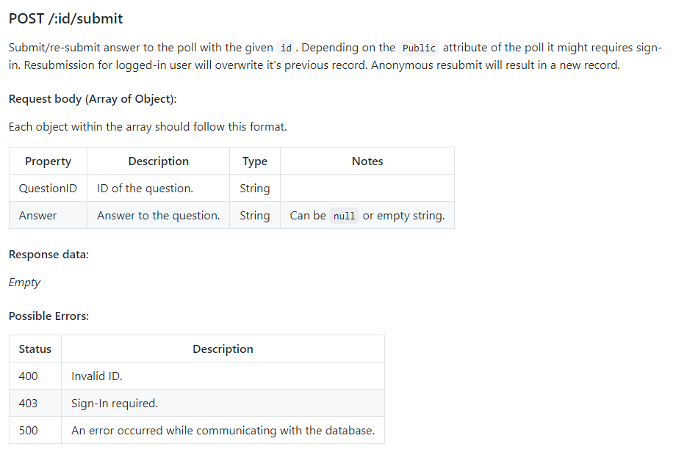
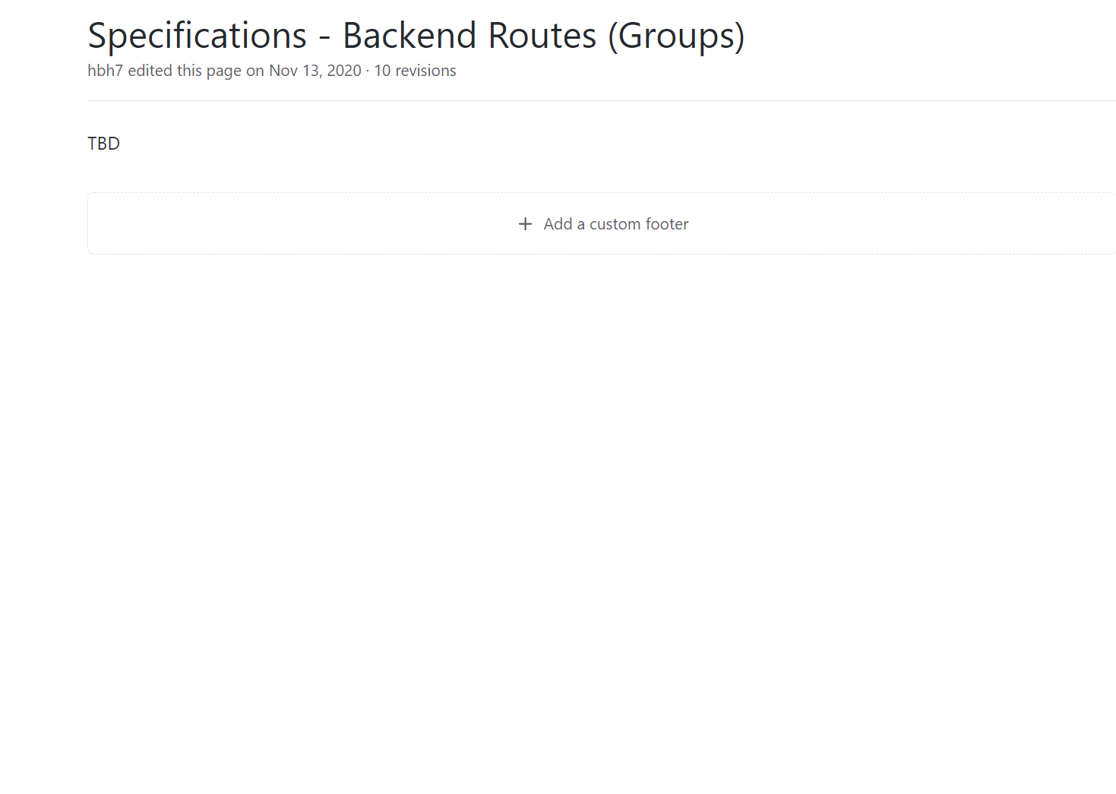
Backend Documentation
Table of Contents
Updated Wiki
to
Notes:
Presenter: Brian Lin
This semester I mostly worked on doing documentation on the back-end. This basically included documentation on all of the endpoints relating to polls in the Poll Buddy database and the technologies we use. There were a couple of sections in the polls specification wiki that didn’t have any documentation, such and now it has a bunch of information on how to use each endpoint, what they do, what they request, and possible errors that could occur. Each endpoint also has similar information in JavaDoc style in the code. This formatting style for the wiki documentation of the endpoints have now become a standardized procedure, since it was approved by Hunter. Furthermore, this RCOS project utilized JavaScript and React, and I’ve never used those languages before. So this semester, I spent time learning both JavaScript and React so that I could become familiar with them for possible future opportunities.

Slide 15
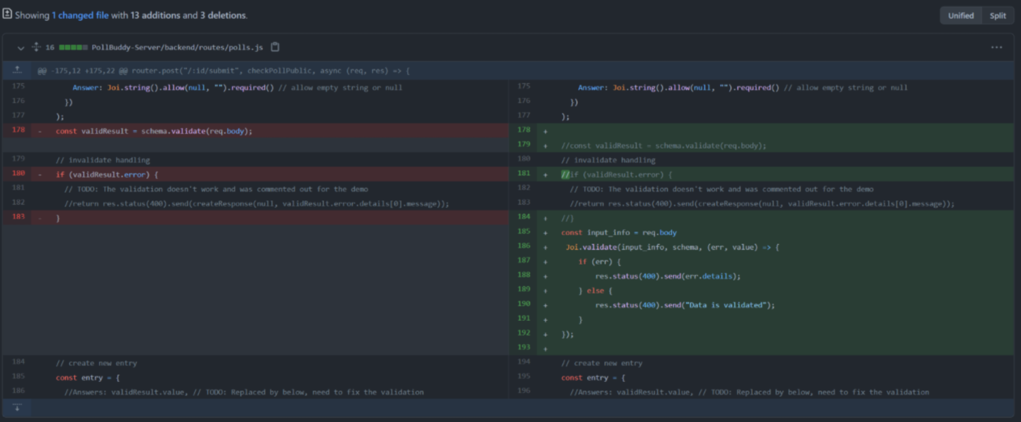
Documentation and validation
Notes:
Presenter: Dingheng Yan
This semester I mainly focused on backend issues and documentations. I wrote an overview wiki page for backend routes and learned JavaScript in order to solve backend issues. I worked on a validation function that check if user input data is valid compared to the answer in database for poll answer auto grading.

Slide 16
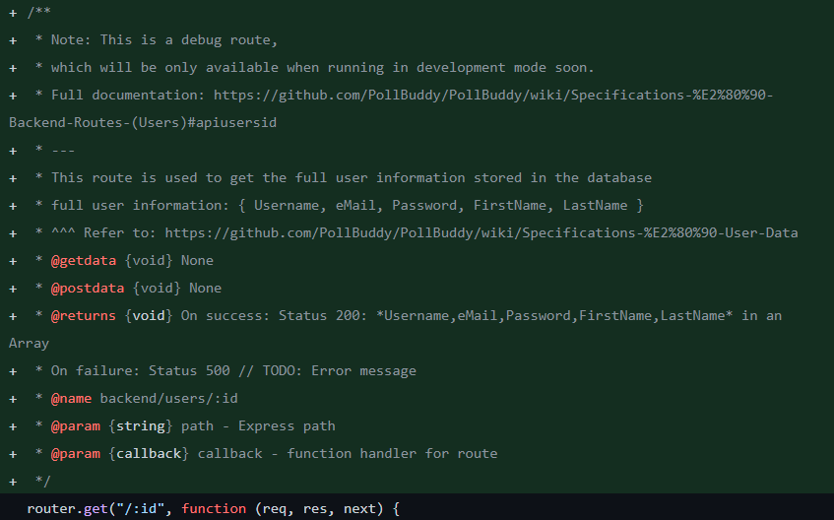
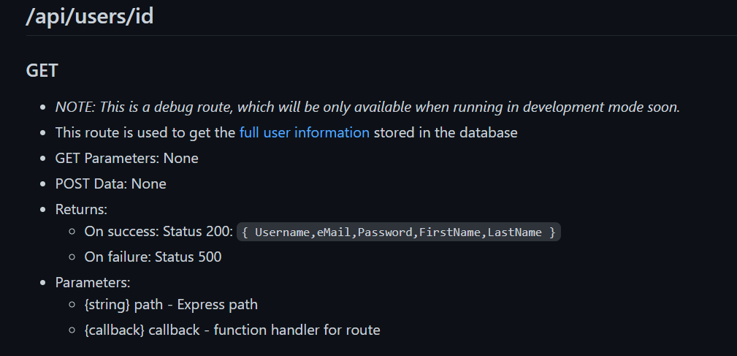
Route Documentation
Notes:
Presenter: Zhenyuan Gong
This semester I learned JavaScript and mainly worked on backend documentation. I documented the route both in code and wiki with the name, parameters, and return values in different conditions. For any related information, I also added a reference link in the documentation for people to check them easily.

Slide 17

Thank You!
Any Questions?
Notes:
Presenter: Hunter
This has been Poll Buddy! Does anyone have any questions?

